Slide 1
CEP Final Project Presentation
By: Heng Teng Yi
Nathan Tew
Evan Lioe

Slide 2
How We Constructed the Station
Base materials:
Two Paperone Copier Paper Holder Lids
4 Satay Sticks
3 Styrofoam Cups (Thanks Chien Hao! :D)
1/20th of a straw
Hot glue
DHT11 sensor
7 Segment LED
Emitter and Receiver (of some kind of light)
Buzzer
Raspberry Pi and GPIO and wires and stuff

Slide 3
Anemometer
Wind Collector
Pushed three satay sticks into the three cups.
Glued the ends of the sticks to a flat piece of cardboard.
Glued the fourth stick to the middle of the cardboard.
Glued the cups on the three sticks in place.
Loop Counter
The emitter and receiver glued onto each lid.
Wheel with a slit on it inserted into Stick No. 4.
Cups + Sticks + Wheel inserted into box such that the wheel covered the emitter.
Feature: Buzzer
Glued buzzer next to a big hole.

Slide 4
Logic
When the wheel was blocking the receiver, the beam by the emitter would not be received.
When the wind pushes the cups, it rotates both the cups and the wheel, such that the slit in the wheel would allow the beam to connect.
When the slit kept moving and the beam was broken, one revolution was registered.
Then, the buzzer sounds for 0.08 seconds at a C pitch.
Repeat!
Every 20 seconds, the number of rounds would be calculated into RPM and uploaded to the server.

Slide 5
DHT11 + Logic
Construction
Glued the DHT11 next to a hole.
Made another hole to fit a 7 segment LED.
Logic
Measured Temp and Humidity
Upload to ThingSpeak server
Display values on 7 Segment LED
Repeat!

Slide 6
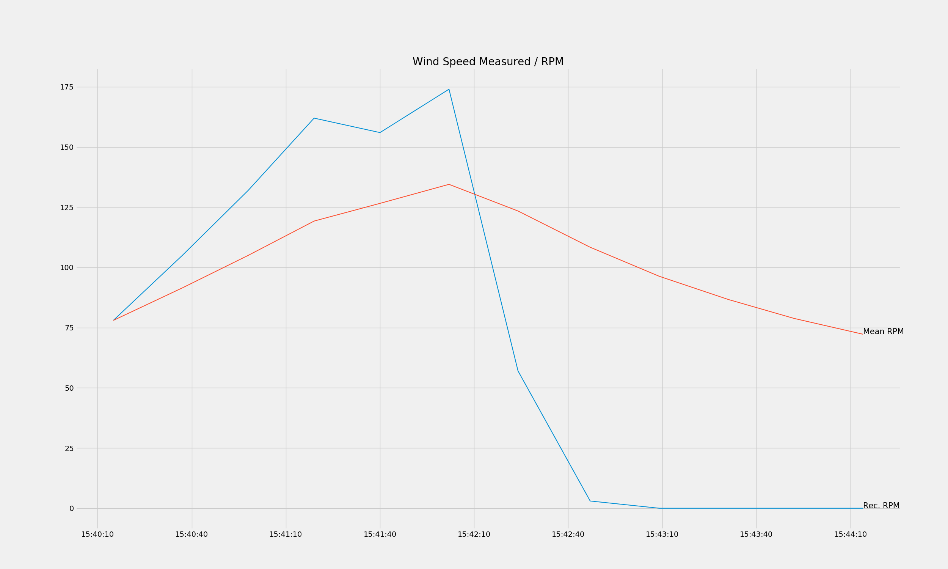
Graphs (Wind Speed)

Slide 7
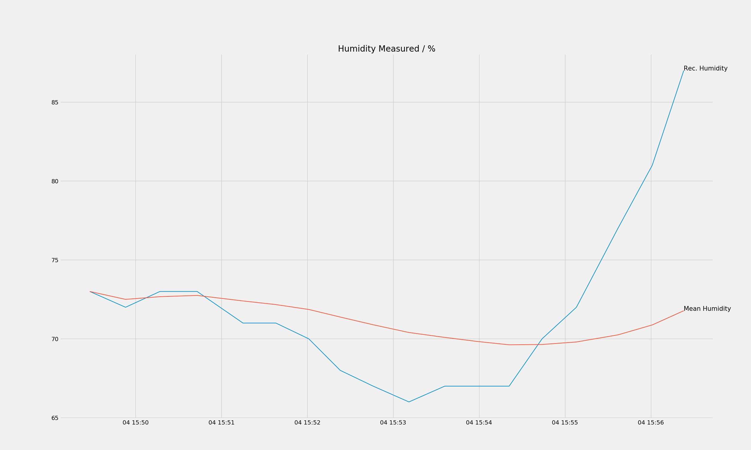
Graphs (Humidity)

Slide 8
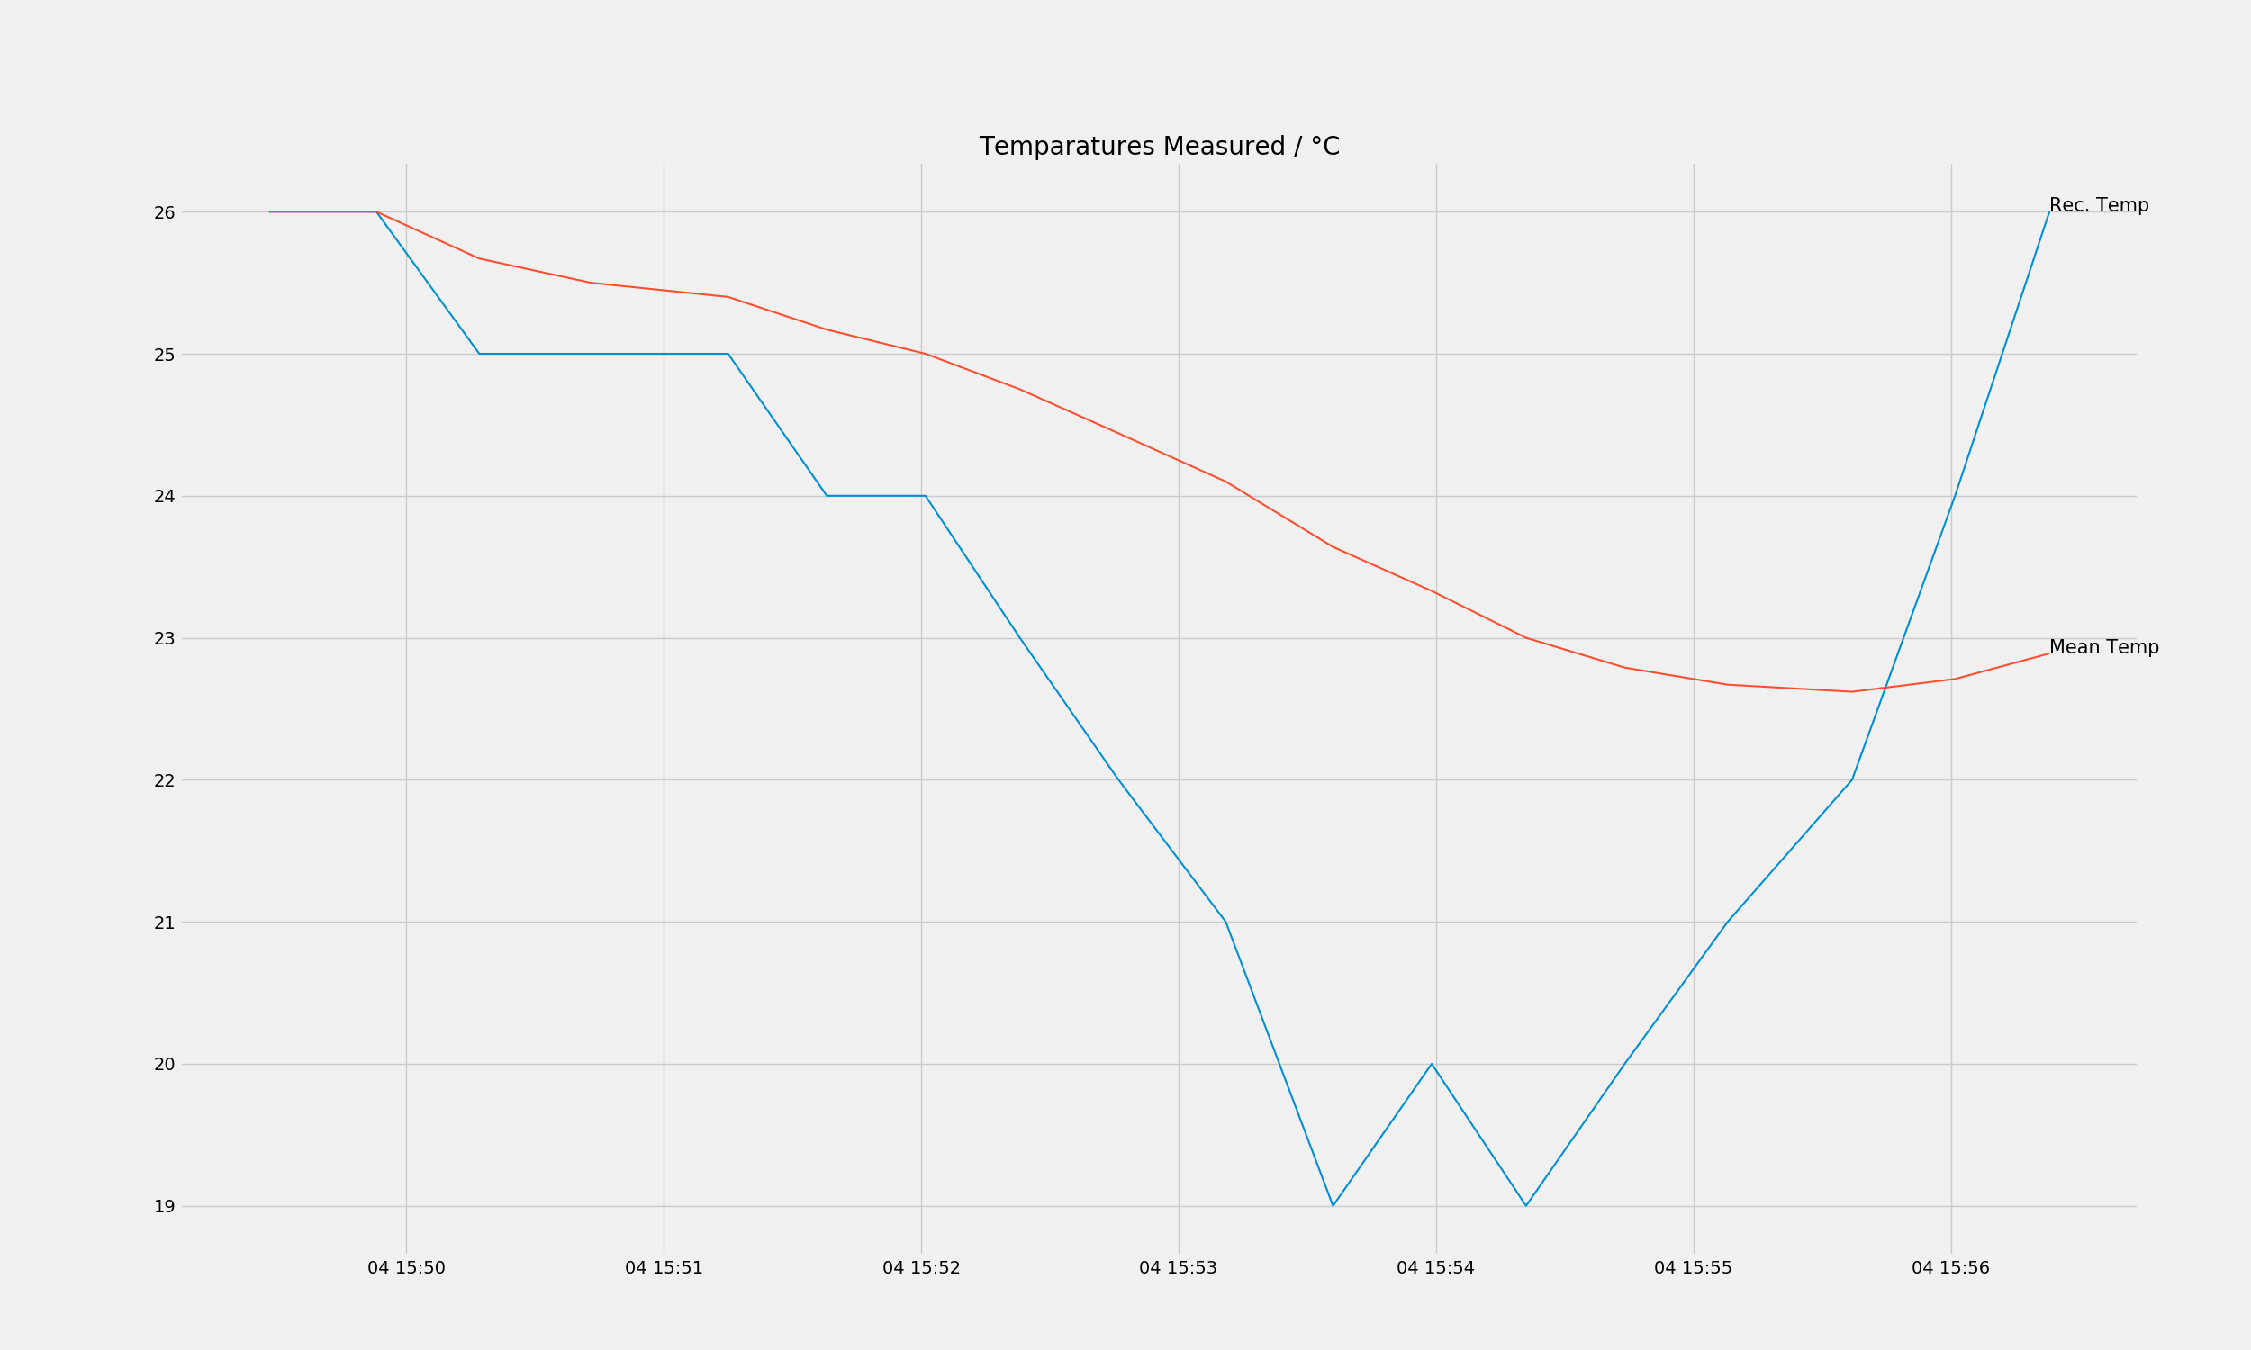
Graphs (Temperature)

Slide 9
Obstacles Faced
Server Limit - 15 sec limit on Thingspeak server uploads for free accounts
DHT11 Meltdown - It melted...yeah.
Data for DHT11 - No easy way to affect readings on the sensor.
Having enough data - 5 minute data yay
Distribution of work - Teng Yi did most of the work (He wrote this too)

Slide 10
Limitations
Takeaways
Learned how to connect all the stuff we’ve learned (Servers and APIs, DataFrames and Plotting), as well as hardware to do a project!
DHT11 sensors are bad….
Planning is important.
Projects are really really hard to do in a short time.
DHT11 - +- 2 degrees Celsius
7 Segment LED - Could not display all our letters

Slide 11
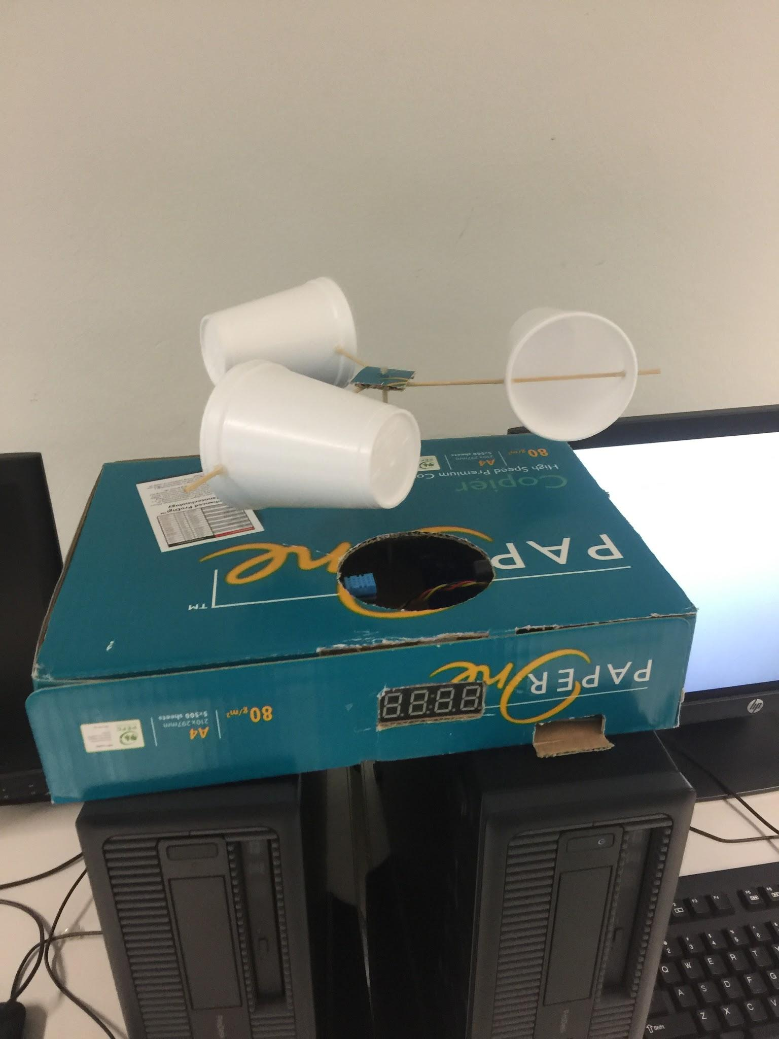
Stuff we did not mention in the actual Presentation (too unprepared)
Stuff we did not think of mentioned but wanted to after the other groups.
Our anemometer spun very well (spun up to 200 rpm and did not break or damage at all).
Our Box was organised and contained into a size ¼ of the other groups (Much more portable).
All components clearly visible with no clutter or visible tape holding it.
Only two wires visible (HDMI and Power) outside of our box!
Best looking one too.

